Slide 1
Getting into
Greeting Cards

Slide 2
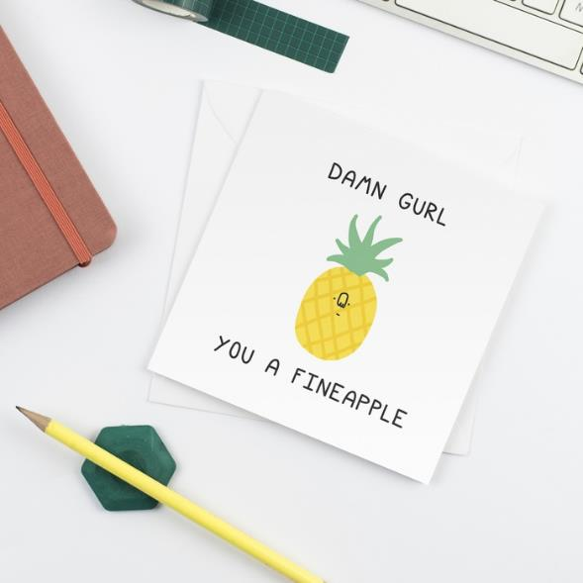
Greeting cards are a leading British Creative industry.
The world of greeting cards
The UK leads the world in greeting card innovation and design, with other countries looking to us for the latest trends.
We export our cards all over the world.

Slide 3
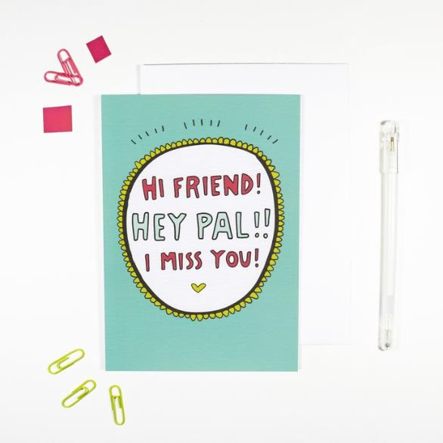
In 2019 we spent £1.7 billion on greeting cards in the UK.
The world of greeting cards
This provides income for artists, writers, publishers, printers, retailers and many others.

Slide 4
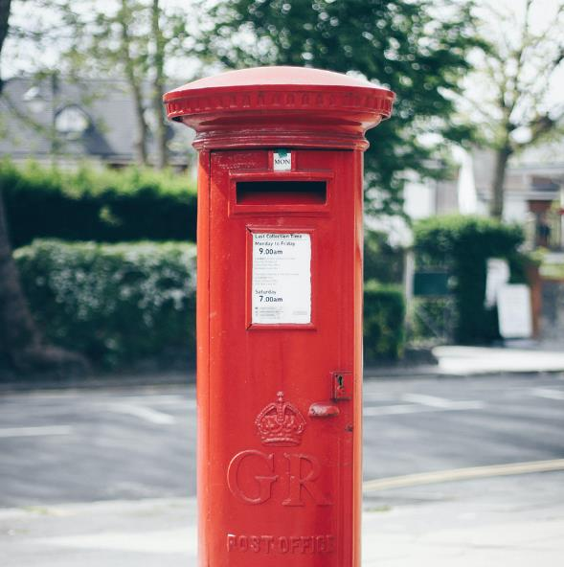
Card sending remains a strong and British tradition.
Why greeting cards?
We send more cards per capita than any other nation.
Cards are a good tangible way of keeping in touch, and mean more than a social media message which are sent all the time.

Slide 5
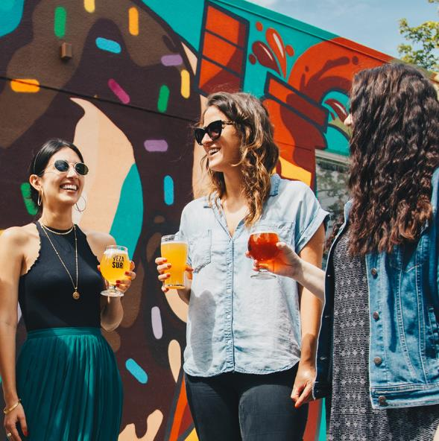
18-34 year olds are sending more cards than a generation ago.
Why greeting cards?
This trend is being seen in USA too – Millennials were responsible for the 44m more cards sent in 2018 according to the United States Postal Service.

Slide 6
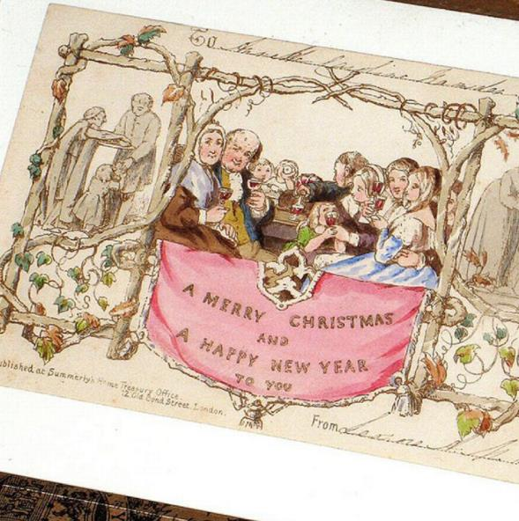
People have been exchanging images and words with loved ones since ancient times.
When was the first card sent?
The first Christmas card was sent in 1843, by a Victorian entrepreneur, Sir Henry Cole.
He commissioned an artist friend to design him a card to exchange seasonal greetings with friends.

Slide 7
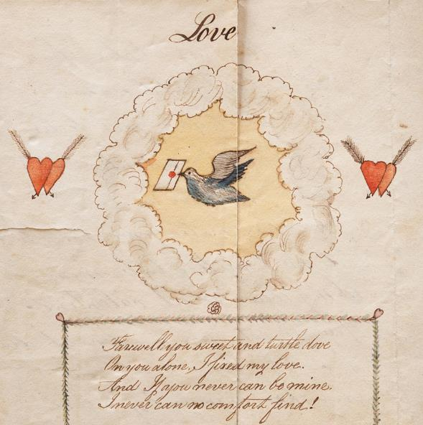
However there are much earlier examples of cards, such as this Valentine’s Day from 1790.
When was the first card sent?

Slide 8
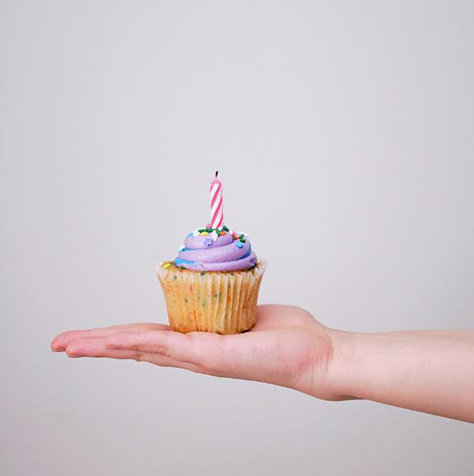
Today we send cards to our friends and loved ones on special days.
Who buys greeting cards?
On days such as birthdays, Mother’s Day, Father’s Day, Valentine’s Day.
We take cards to weddings, parties and christenings and send cards to say Happy Christmas.

Slide 9
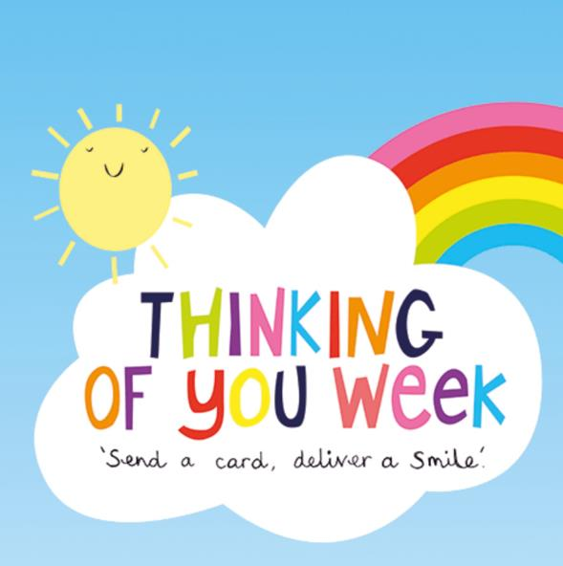
We also send cards just to share a joke, keep in touch or say ‘thinking of you’.
Who buys greeting cards?
The growth in sending cards to say ‘thinking of you’ has led to the 3rd week in September becoming known as Thinking of You Week, celebrated in the UK, USA and Australia.
People are on social media all the time, to send a heartfelt message to someone special more effort is needed - and that’s a card!

Slide 10
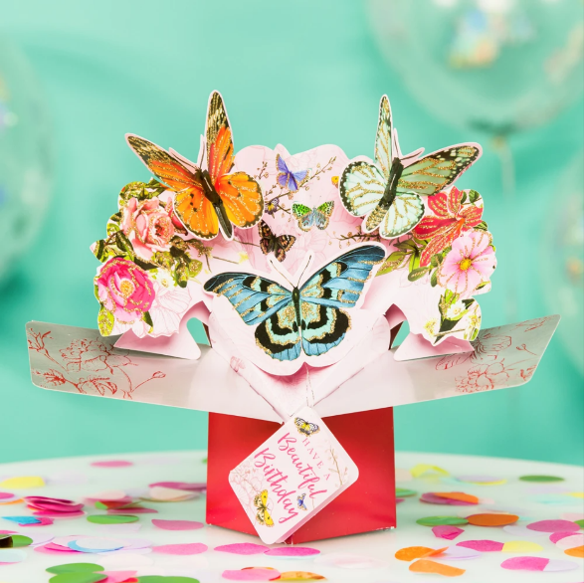


Slide 11


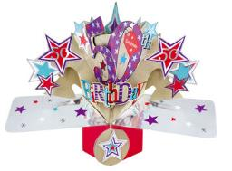
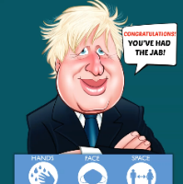


About us
The business was founded by Rod Schragger in the 80’s. At the time there were very few specialist card publishers in the market and the designs at the time were very traditional so he felt there was a real opportunity to create something new and exciting in terms of design.
Rod’s inspiration to join the industry was the social connection to the way we live and feel and the way a card can truly encapsulate these feelings at a particular moment in time creating a keepsake memento. Not only can a card be a way of sending sentiment but a card can be a mirror of society’s issues and attitudes at a particular point in time.
As Rod is not a designer or artist himself, he started the business by buying in what were (at the time) new and exciting designs from the USA and selling them to individual retailers until he decided to start publishing cards himself from UK artists he found.

Slide 12
About us
We’re a family-run business trading for over 35 years and whilst we started out producing photography, humour and foil cards, we’re now best known for our design and innovation in hand-crafted cards.
We publish a diverse collection of cards, including open birthday, occasion, relations, milestone & juvenile ages as well as seasons.
Our key brands include multi award-winning Second Nature Pop Ups, Champagne, Just To Say, Yours Truly and as recently featured on Good Morning Britain we also distribute Really Wild 'Politically Incorrect' cards.

Slide 13
About us
Our head office and studio is based just off Portobello Road in London and our customer services, warehousing and distribution are all run from the Isle of Wight. With sales consultants on the road, we employ over 60 people directly and with exclusive factories working for us probably have a couple of hundred people working in the supply chain for us between the UK and The Far East.
The entry level these days with digital printing can be very small but there is a key decision to be made in terms of;
  do you want to become a publisher and have to take on all aspects of a modern day business or
  focus on being an illustrator / designer

Slide 14
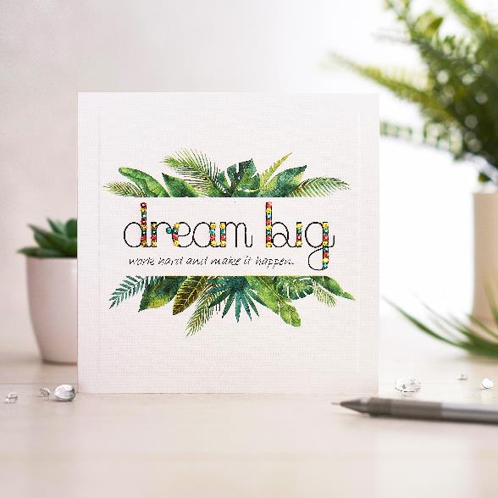

Slide 15
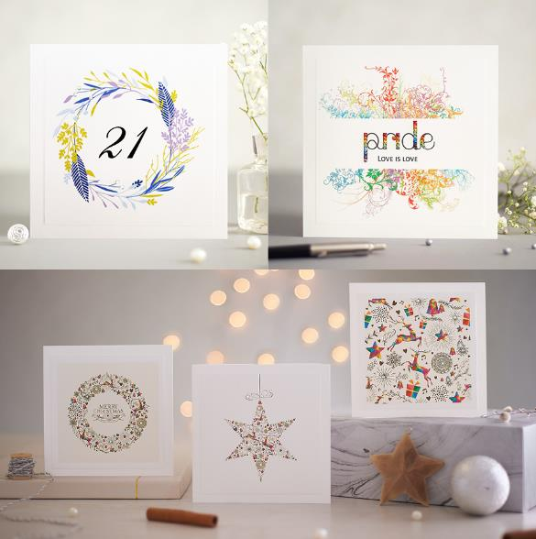
Mrs Lovesy story
I create luxury hand finished cards.
Mrs Lovesy was born of a desire to do something creative which was more my passion.
I launched Mrs Lovesy in 2015 whilst on maternity leave with my eldest son Lucien.
At the time I was working in the Finance Sector as an Investor Relations Administrator.
I meant this to be a temporary job after graduating but I had been working in that role for 4 years.
I decided it was now or never to pursue my passion.

Slide 16
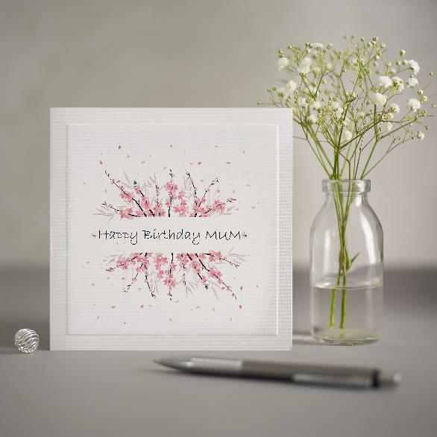
Mrs Lovesy story
What appeals to me most about the greeting card industry
The opportunity to be part of something positive.
You are creating something that can bring joy and comfort to everyone.
I have a degree in Fine Art from the Slade School of Fine Art London, so I had a creative background
It is a good business model because one design can be sold many times over.
I run my business from home (not just due to lockdown) which works well for me because I’m a mother of three small children aged 6, 3 and 1.

Slide 17
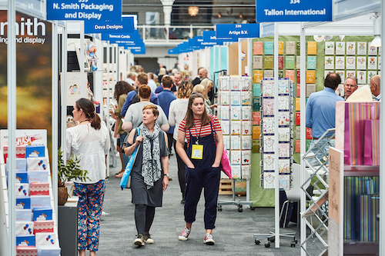
Mrs Lovesy story
Some tips for getting started
Tradeshows are the best way to be introduced to retailers and distributors.
My first tradeshow was PG Live 2015 and that is where I met my French distributor and gained my first retail customers.
I sell wholesale to retailers UK-wide and export to France via a distributor.
I also sell direct to customers via ETSY and Not On The High Street.
That same year I was a finalist for a prestigious Henries Award.
The Henries awards take place each year and are the greeting card industry's answer to the Oscars!

Slide 18
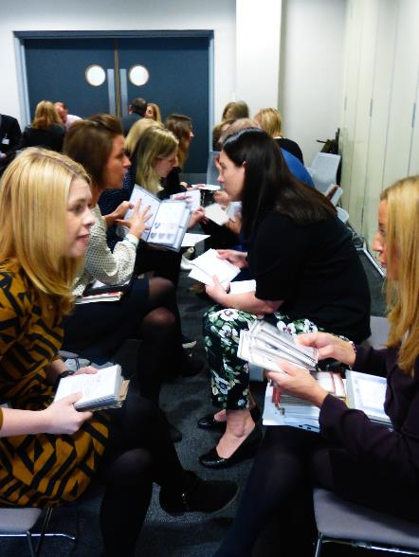
Mrs Lovesy story
The GCA is here to support
When I first started my business, I had very little knowledge about the greeting card industry
I had lots of questions, so I decided to joined the GCA.
I found the GCA members to be very helpful and the GCA website a good source of information.
The GCA also run events such as Dragons Speed Dating where retail members find prospective new publishers and publishers meet and present their designs to a range of key industry buyers.
By attending that event I got useful feedback on improving my products and got noticed by a multiple retailer who I’ve now been supplying to for several years.
After 5 years of running a greeting card company, I was honoured to be selected to join the GCA as a council member in 2020.
It is a role I’m very excited about as I can use it as a platform to help others starting out in the greeting card business.

Slide 19
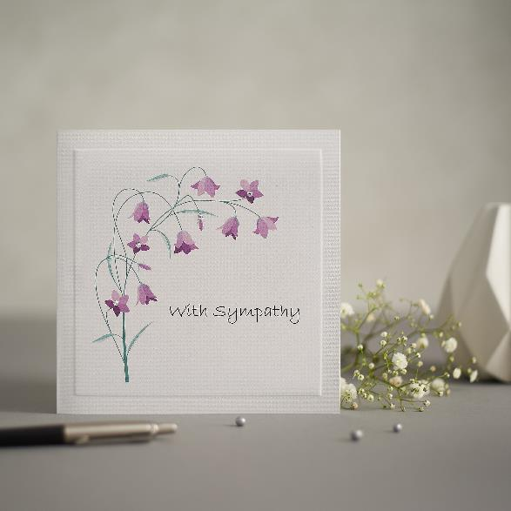
Mrs Lovesy story
What have I learnt about greeting cards in general?
My first card designs were only doing blank cards because I thought they would be more versatile.
I soon realised by adding an occasion to a card design I generally sold more.
It surprised me that simply adding “Happy Birthday” or “Thinking of you” to the front of a card could greatly increase my sales.
The majority of my cards now are occasions cards, but I still have a few blank cards.

Slide 20
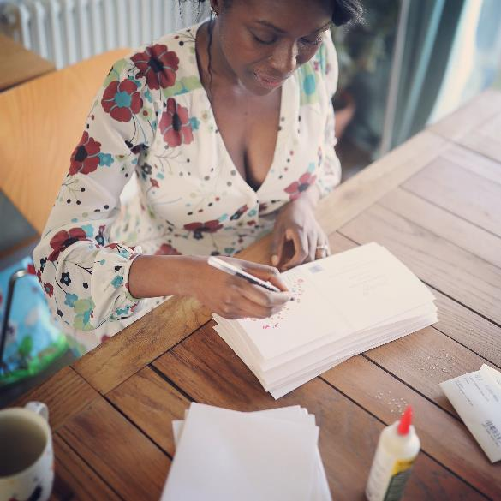
Mrs Lovesy story
It’s a great industry, but you need a way to stand out
I class myself as a handmade/hand finished luxury brand and maintain this by ensuring I use high quality materials.
Each of my card designs are hand finished using glass crystals instead of cheaper plastic alternatives.
I use a luxury 350gsm board and get my card designs professionally printed to ensure a high-quality finish.
My cards are printed in the UK and all the materials are sourced from the UK making me a truly British brand.
My top tip for all small greeting card publishers is to find your own style and know your USP.

Slide 21
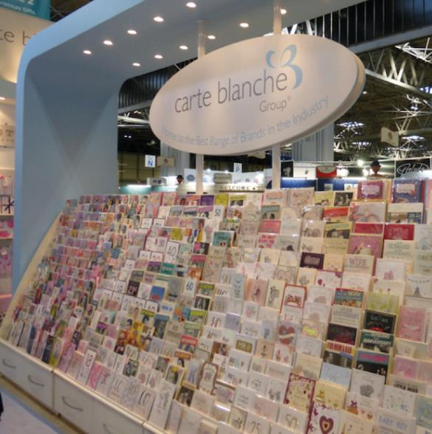


Slide 22

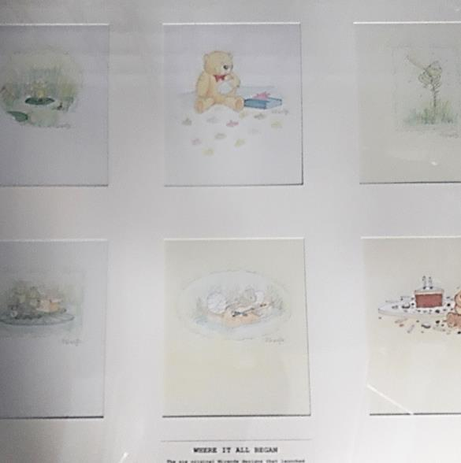
About us
Founded in 1987 by our Chairman, Stephen Haines with just 6 greetings card designs
CBG is now The largest Independently owned Greetings Card Publisher in the UK

Slide 23
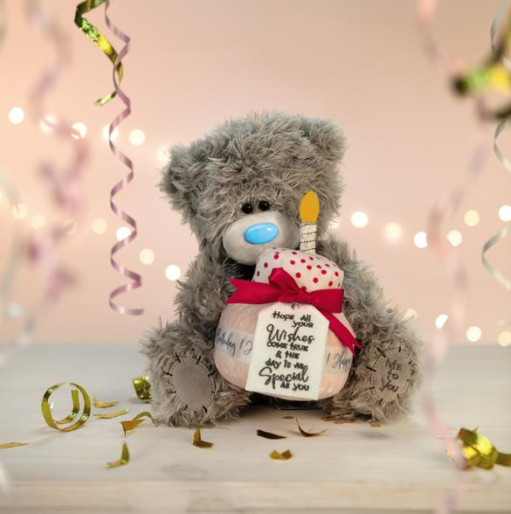
Our brands
Home to some of the UK’s best loved brands including:
Me to You
Tiny Tatty Teddy
My Blue Nose Friends
Violent Veg
Wishing Well
Hotchpotch
All Creatures

Slide 24
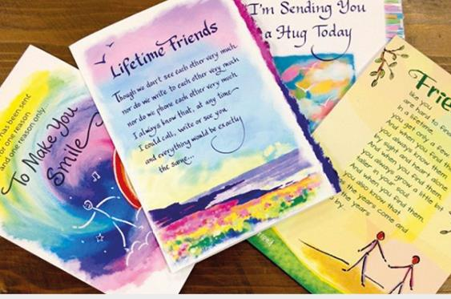
Distribution
With strength in sales, marketing and service we have also distributed cards for other brand owners
Blue Mountain Arts

Slide 25
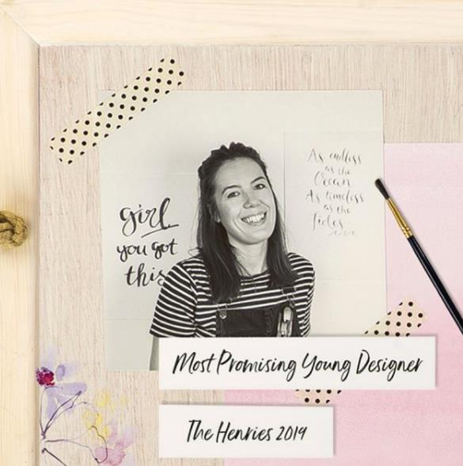
About us
Carte Blanche employs over 110 members of staff from Artists and Designers, Sales, Marketing and Licensing professionals, Product developers, Supply chain experts, IT, Customer Service and operations teams, visual merchandisers and warehouse operatives, all from our offices near Chichester and a small satellite design studio for our Hotchpotch brand just outside of London.
Carte Blanche has won many awards for its products and business generally, including the HSBC Fast Track 100 award, Popei Awards for our in-store displays and POS, Design, Product and Licensing Awards

Slide 26
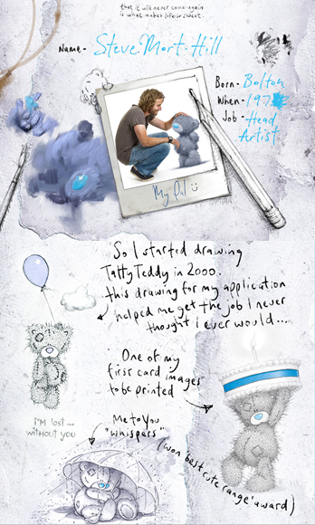
The importance of illustrators
Illustrators have such an important place in our business
Our head artist is Steve Mort Hill – from creating portraits on the corner of Trafalgar Square and dealing cards in a casino amongst other jobs, a small sketch and natural ability to illustrate has opened up a fantastic career for Steve
Many artists, designers and illustrators have found opportunities within the greeting card industry
You don’t have to just draw cute –humorous designs, traditional, contemporary or even fine art all have a place

Slide 27
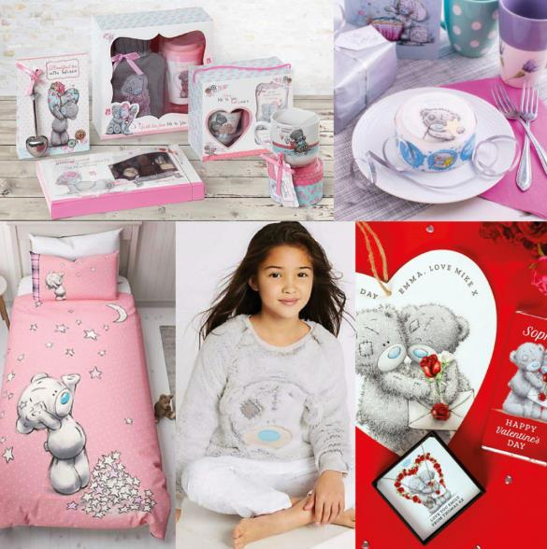
Me To You
One of the most recognisable brands in the UK – 96% brand awareness!
Brand found in over 9000 retailer rooftops in the UK
150,000 Me to You cards sold each week
13% of the UK population receive a Me to You card each year
Me to You has brand presence in 190 countries
Licensed in 12 product categories from cakes to toiletries, chocolate to apparel, homeware to crafting
All of this started from a greetings card…..

Slide 28
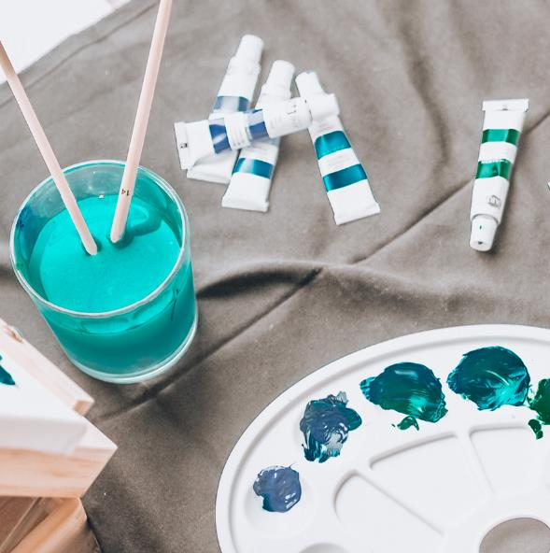
The UK card industry leads the world in innovation and design.
How can you become a greeting card artist?
It’s a highly competitive industry, but there’s always room for new ideas and talent.
There are two main routes for budding new artists:
You can either become a greeting card publisher yourself, or
You can create and supply your artwork to existing publishers and be paid a fee for doing so.

Slide 29

There are two emotional aspects to sentiment a greeting card can convey.
How can you become a greeting card writer?
The visual aspect, and the written word.
Both complement each other and writing the words for a greeting card, both on the cover and inside, is also an art.
The writer has to understand sentiment, humour, emotion, grammar, tone & more – to convey a message in a few words with the appropriate image from sender to recipient.

Slide 30
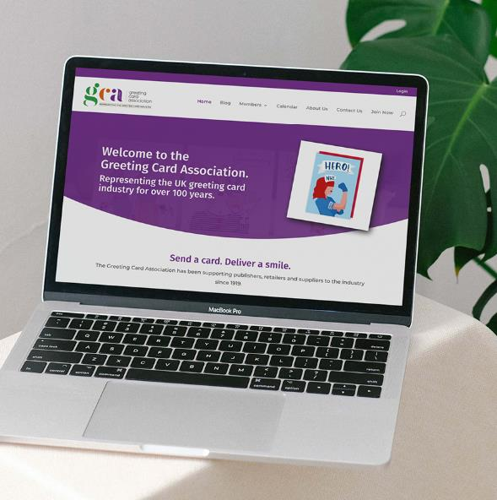
The GCA has lots of tips and info…
Where can I get more information?
Visit gca.cards to learn more!
Visit the ‘Work in the Industry’ section to find companies looking for artists and writers (gca.cards/jobs).
And see our Members Directory to find companies you may want to approach (gca.cards/directory).

Slide 31
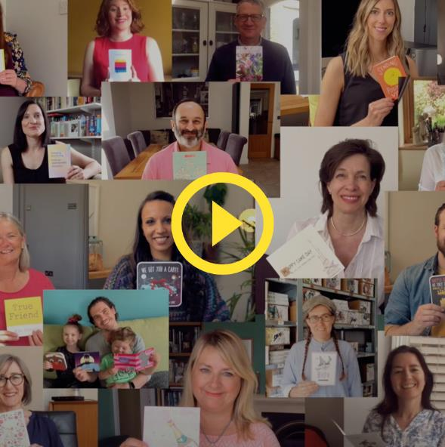
This film was made by the greeting card industry in 2020, during the first lockdown.
The joy of receiving a card
It was shared to illustrate the joy of receiving a card, and remind everyone to keep in touch with loved ones isolating during COVID-19.

Slide 32
Any questions?
For more info visit gca.cards

